Slide 1


Data Analysis
Notes:
Hello and welcome, my name is Jagan Saravana and today I will be presenting to you the results of the Data Analytics task.

Slide 2


Today's agenda
Project recap
Problem
The Analytics team
Process
Insights
Summary
Notes:
Today's agenda will be as follows:
1. We will recap the overall project to give a high level understanding of the business problem we're tackling and the specific requirements.
2. We will dive into the specific problem that we, the Data Analytics team, have been focusing on and will give some background as to why this is such a big problem.
3. After introducing the problem, I will go over the team responsible from our side in tackling this task.
4. I will then go over the high-level process that we followed to complete this task, so that you have complete clarity in how we tackle these kinds of tasks.
5. Finally, I will go over the all important results and I will present them as a series of insights and visualization's from our analysis.
To wrap up, I will summarize and open for any questions.

Slide 3

Social Buzz is a rapidly growing tech unicorn that must quickly adapt to its global scale.
Accenture has begun a 3 month POC focusing on these tasks:
Audit of Big Data Practices
IPO Success Recommendations
Analysis of Top 5 Content Categories
Project Recap
Notes:
To kick things off let me recap this engagement.
We, Accenture have embarked on a 3 month pilot with Social Buzz to focus on 3 main tasks, aligned with some of the biggest challenges that you're currently facing.
Social Buzz has reached huge scale in recent years to become recognized as a global unicorn company. We are here to help you manage this scale and to guide you in the right direction.
Firstly, we will be doing an audit of your big data practice and sharing best practices and industry expertise. Secondly we will be guiding you through a successful IPO, of which we have deep expertise and knowledge of within our team. And finally, we have conducted an analysis of your data to find insights regarding your top 5 most popular categories of content

Slide 4

Problem
100,000+ posts daily
36.5 million pieces of content yearly!
How to leverage this vast amount of content?
Analyzing Social Buzz’s top 5 content categories
Notes:
Focusing on the last point mentioned, this is the specific area where the Data Analytics team has concentrated their efforts.
With such a large scale, the platform generates a tremendous amount of data, which brings significant challenges.
To provide some context on the volume of data generated:
Your platform receives over 100,000 posts per day, totaling 36,500,000 posts annually. This is all unstructured data, making it difficult to analyze and interpret.
In today's digital landscape, content is paramount. Major platforms like YouTube, Facebook, and Netflix are all fundamentally content businesses.
The challenge lies in capitalizing on the vast amount of content. It's not just about accumulating content; the real value comes from understanding and analyzing it to gain deeper insights into your audience, thereby enhancing personalization and user experience.
This is where our data analytics expertise is crucial. With the insights we've derived from this task, we can demonstrate how to implement analytics at scale to drive meaningful outcomes.

Slide 5



ANDREW FLEMING
Chief Technology Architect
The Analytics team
MARCUS ROMPTON
Senior Principal
JAGAN SARVANA
Data Analyst
Notes:
Talking about experience, we have a large data analytics practice at Accenture but we had a team of 3 people primarily focusing on this task. Andrew Fleming is our Chief Technical Architect and his expertise helped to guide the team to produce high-quality analysis.
Marcus Rompton, a senior principal has worked with the world’s biggest clients on solving their data problems and was heavily involved in the data engineering side of this project.
And finally myself, Jagan Saravana , who was solely responsible for taking leadership guidance and delivering high-quality insights from the raw datasets and turning these into business decisions.

Slide 6
Process
1
Data Understanding
2
Data Cleaning
3
Data Modelling
4
Data Analysis
5
Uncover Insights
Notes:
So, how did we tackle this problem?
Well we approached it in 5 steps:
1. Data understanding - the key to success on any data project is to understand the data in detail. So we took the time to understand the data model and domain of your business.
2. Data cleaning - after understanding your business, we then cleaned the available datasets and thought about what an ideal dataset should look like for this problem.
3. Data modelling - After ensuring the data was clean for analysis, we needed to process and model this data into a dataset that can precisely answer the business questions and produce the results needed.
4. Data analysis - With our new dataset, we used our analytical expertise to uncover insights from this dataset and to produce visualizations to describe the insights.
5. And finally we used these insights to unlock business decisions and to make recommendations on next steps.

Slide 7

Insights
16
1897
MAY
UNIQUE
CATEGORIES
REACTIONS TO “ANIMALS”
POSTS
MONTH WITH MOST POSTES
Notes:
From your data we found that you had a total of 16 unique categories of posts across your sample dataset. This includes things such as Food, Culture and travel.
As well as this, there were 1897 reactions from just the animal category alone! People obviously really like animals!
And also the most common month for users to post within was May.
But now, onto the main question... which is... what were the top 5 most popular categories of posts?

Slide 8
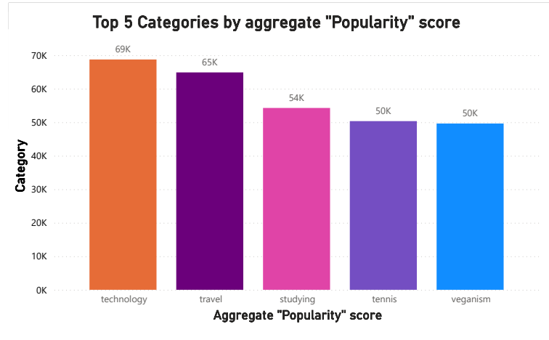
Notes:
From our analysis, you can see that the top 5 most popular categories of posts were technology, travel, studying, tennis, and veganism in descending order.
Technology had an aggregate popularity score of around 69k. It is very interesting to see both tennis and veganism within the top 5 have an equal popularity score of 50k. The second most, which is not surprisingly travel, is actually that we all love to travel to explore new places, new people, and different foods, which gives different good feelings, and it shows that most people prefer travel, as can be seen in the popularity score of 65k. Then studying is a human's day-to-day necessary thing to learn, explore, and upskill new things, and most of the youngest prefer to learn new things, including myself, and some people will have a habit of learning something new in their day-to-day lives.
Finally, it's also interesting for tennis and veganism too. This may suggest that people enjoy their time playing tennis, and it is good for our body and muscles. Veganism is a really good habit of preferring only vegetables, which is good for health, and there are so many benefits to consuming vegetables in our daily lives, and it keeps us young and provides active energy in our day-to-day lives.

Slide 9
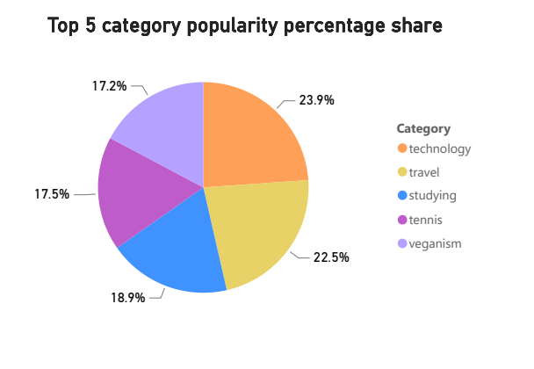
Notes:
Additionally, you can see from this chart the % split of popularity between the top 5 categories. There is not much difference between the share of each category, however, the difference between the 1st most popular, technology and the 2nd most popular, travel, is the largest gap equal to 1.4%.
In business terms, this could suggest that the most popular category, technology, is tailing away from the rest of the categories and may continue to get more and more popular. To avoid an issue where 1 content category consumes the entire platform, it will be important for you to ensure that any algorithms used to govern the content on the platform gives a fair balance to the content categories.

Slide 10

ANALYSIS
Technology and travel are the two most popular categories of content, indicating that people enjoy content related to innovation and exploration. This preference shows a fascination with the latest advancements and the thrill of discovering new destinations. Audiences are captivated by both cutting-edge tech and the allure of travel experiences.
INSIGHT
Summary
Here is an insight similar to the one in the image, but focusing on "Technology" as the common and highest-ranking theme. Technology is a common theme with the top 5 categories, with "Tech Innovations" ranking the highest. This indicates a strong interest in technology within your user base. You could use this insight to create targeted campaigns and collaborate with tech brands to boost user engagement.
NEXT STEPS
This ad-hoc analysis is insightful, but it’s time to take this analysis into large scale production for real-time understanding of your business. We can show you how to do this.
Notes:
So to summarize:
We tackled this task and found the top 5 most popular categories as asked, but we also went one step further.
- We found that technology and travel are the two most popular categories, suggesting that users like “tech-life" and “e" content
We also found that Studying is a day-to-day necessity for learning and upskilling, preferred by many, especially the young. Tennis and veganism, both scoring equally in popularity, indicate an interest in physical fitness and healthy eating habits.
- As much as this analysis was insightful, we are ready to take it to the next stage and we have the expertise within Accenture to help you realize these kinds of insights in production across your organization and in real-time. We would love to help you with this.

Slide 11
Thank you!
ANY QUESTIONS?
Notes:
Thank you very much for listening, please feel free to ask any questions that you may have!

